Slide 1

Data Insights
Loan Data To Answer the Question:
What factors affect a loan’s outcome status?

Slide 2

Introduction to Loan dataset
This dataset about the various variables and factors related to a Loan taken. It has 113937 entries with 81 features, including features of primary importance including loan Term, Loan Amount, Interest Rate, Monthly Income, etc.

Slide 3

Univariate Exploration of data

Slide 4
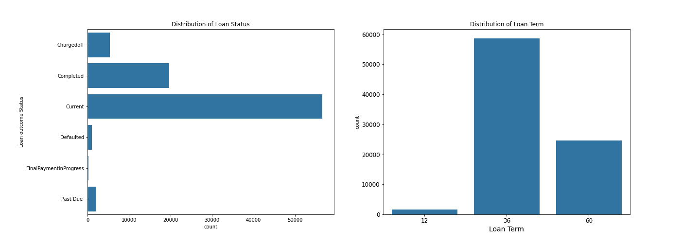
Distribution of Loan status And Term most of loans is in current status, and term tends to be 36 months.

Slide 5
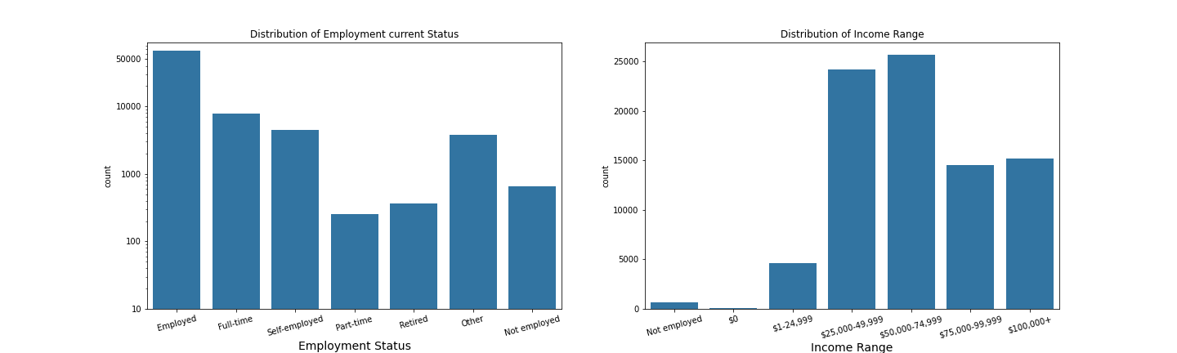
Distribution of loan employment status and Income Range in first plot the most loans is in employment direction, and from second plot the Middle-class people attends to present more loans.

Slide 6
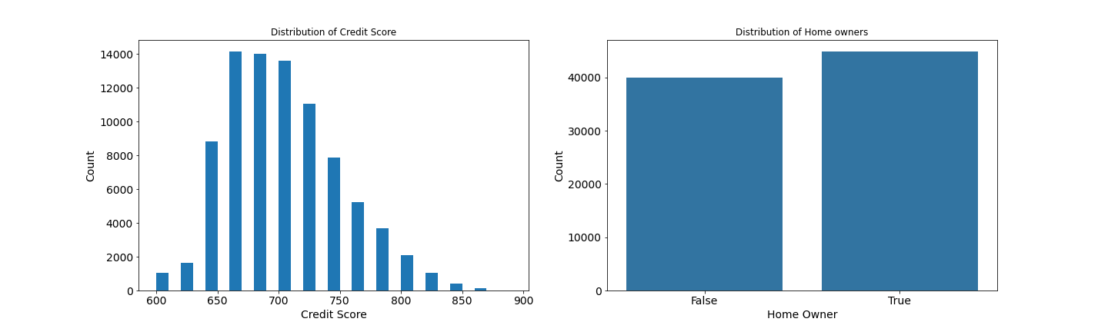
Distributions of Credit Score and Homeowners the Credit score is normally distributed, and its bins are discrete in nature, and from about 660 to 700 we get the max credit score proportions, and from the second plot we could say it's evenly distributed.

Slide 7
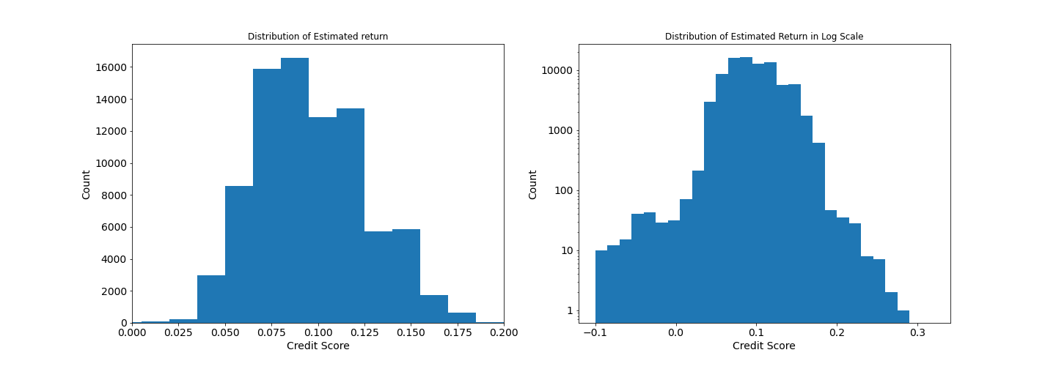
Distribution of Estimated return
It's normally distributed with mean about 10%.

Slide 8
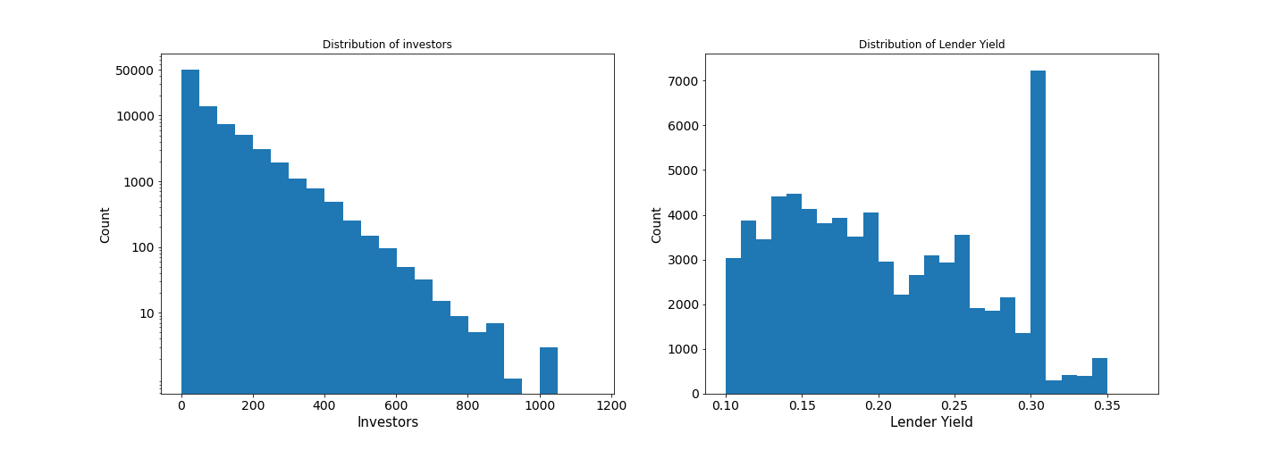
Distributions of Investors and Lender Yield
From first distribution we get that most of loans get lower number of investors, and the second one we got that most lender yield in 30%.

Slide 9
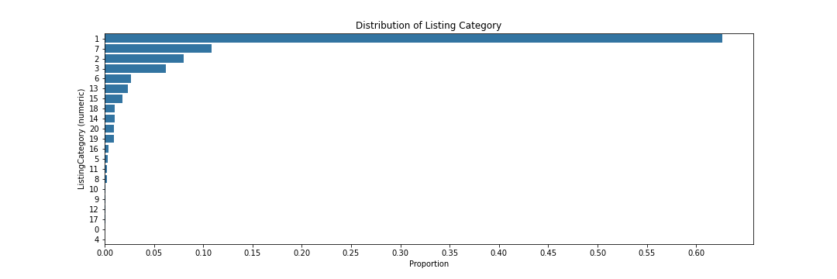
The num 1 related to Debt consolidation and it takes over 60% of loan !
I think that's because of country government politics.

Slide 10
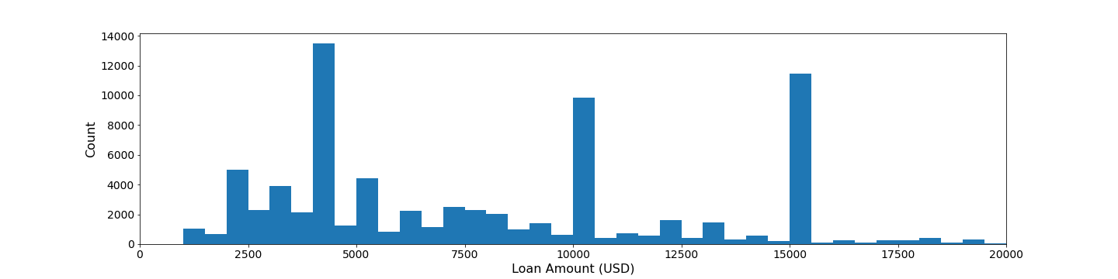
Distribution of Loan Amount

Slide 11

Summary of Findings in univariate plots
In the Univariate exploration of Prosper Loan Data, I made plenty of exciting discoveries.
I found that most of Loan status are Current status.
Middle Class gets most of loans.
Over 50% of loan is taken for Debt consolidation! Quite unexpected.
Another interest discovery was that a 3 years loan term is the most preferred. And finally, Credit score of 1000 is average, which is very good.

Slide 12

Bivariate Exploration of Data

Slide 13
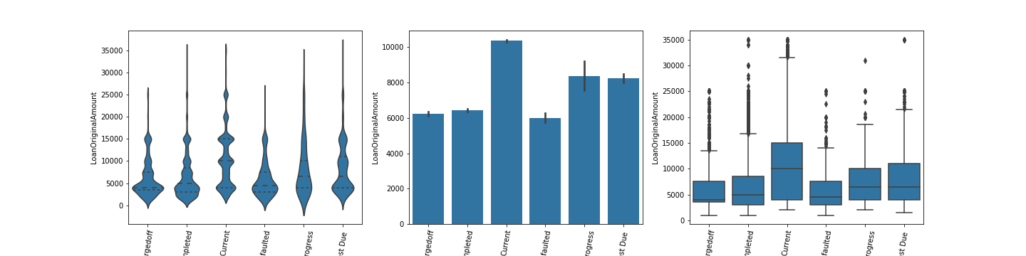
The Relation between Loan Status and amount
The higher loan amount tends to have more loans of current status.

Slide 14
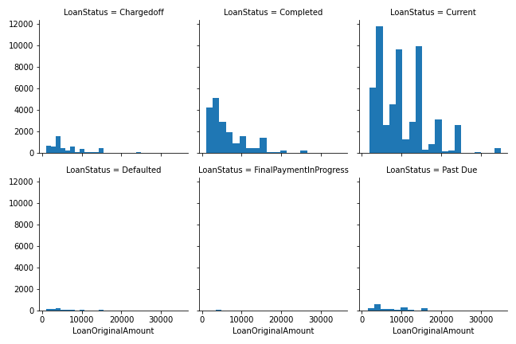
Relation no.2 between Loan Status and amount
This plots accept the idea of loans in current status and tends to have higher Loan Amount.

Slide 15
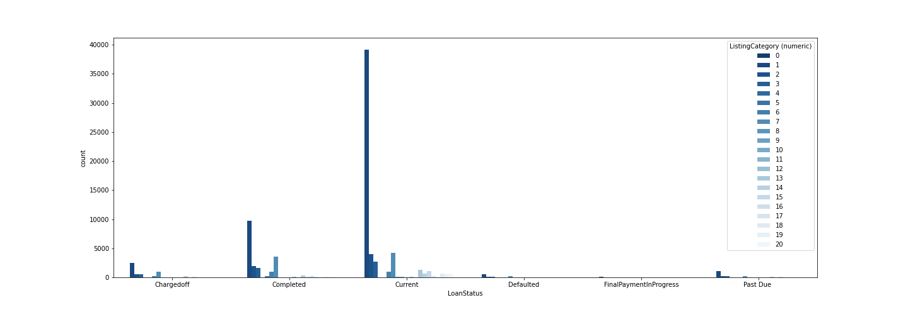
The Relation between Loan Status and Listing Category
Debt consolidation is the higher in all status, Especially current status.

Slide 16
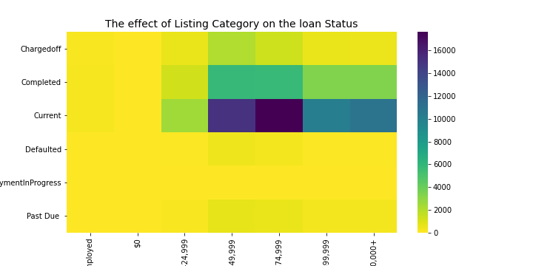
the most of Loans in the Debt Consolidation and some in others listing category and most of them is in Current Loan Status with some in Completed Status.

Slide 17
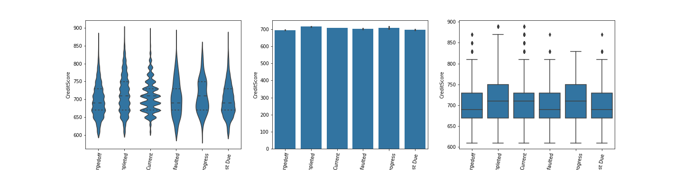
Relation between Loan Status and Credit Score
It's quite not clear but higher score tends to complete the loan

Slide 18
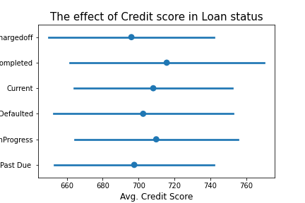
As we see, The Mean credit score doesn't affect the Loan status so much, but we can say that higher score has higher completed loan status.

Slide 19
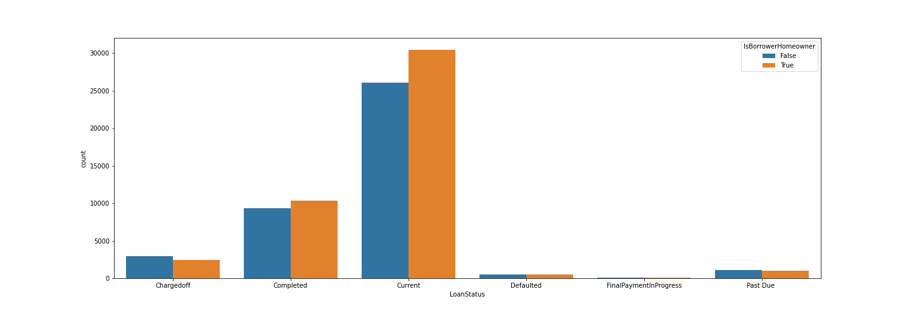
I see in Current Status there's more homeowners.

Slide 20
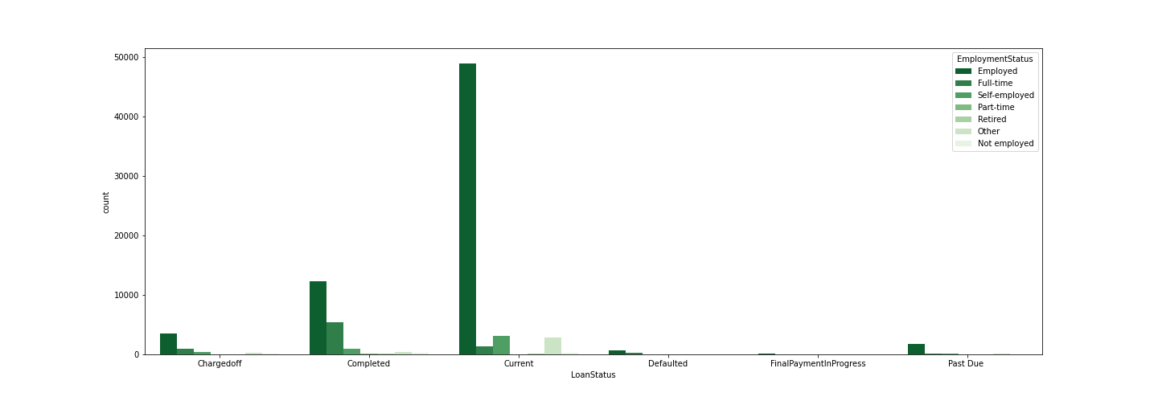
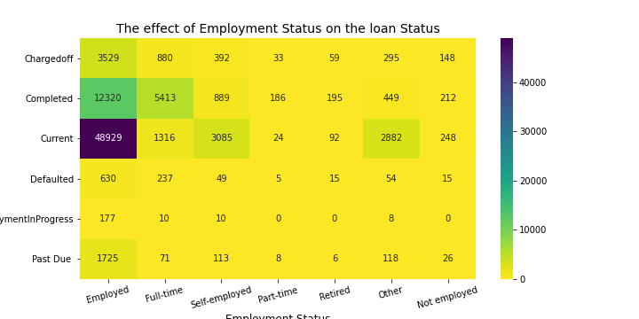
The effect of Employment Status in Loan status
It goes to the Employment direction especially The current and Completed status

Slide 21
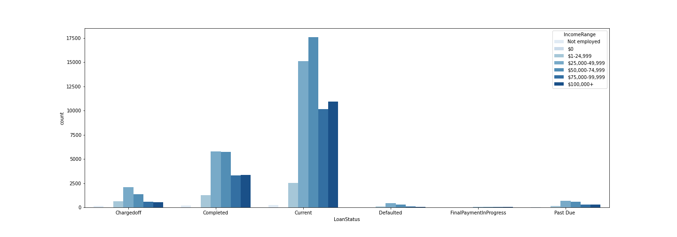
The effect of Income Range in the Loan Status
We need some another plots to say that middle class people gets more loans

Slide 22
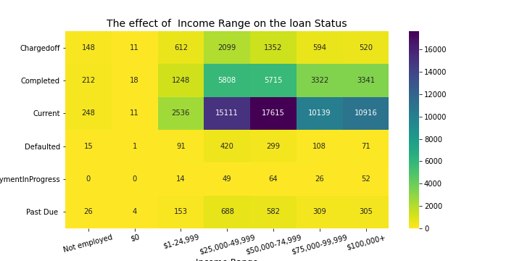
I see that the middle class then the rich people gets more loans specially in current Status.

Slide 23
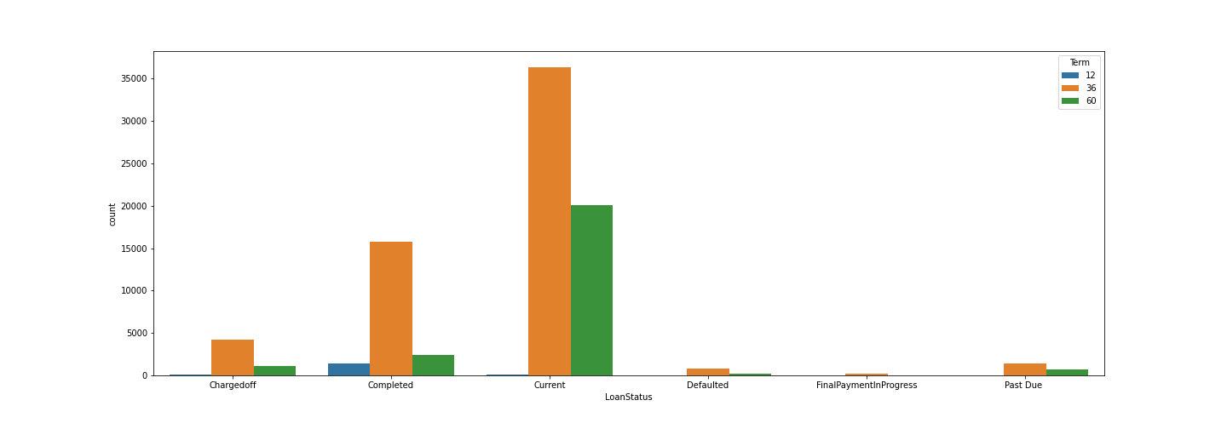
The effect Term in the Loan Status people in most status tends to get 36 Months loans then 60 Months.

Slide 24
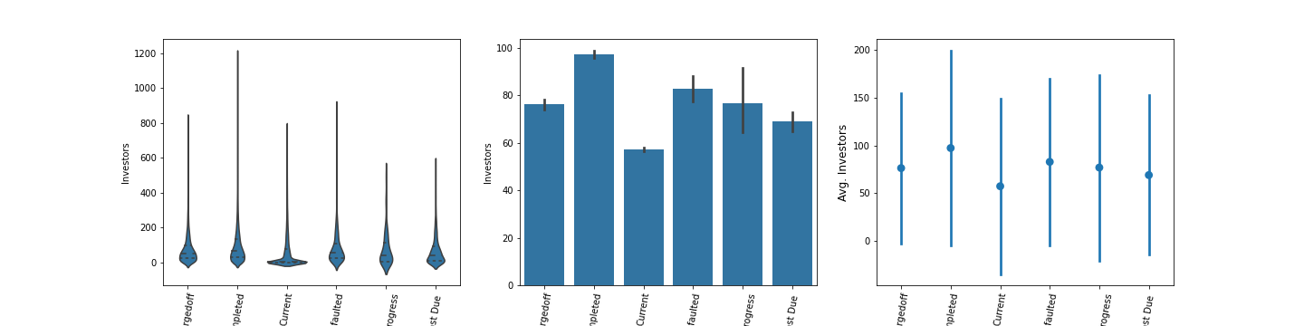
Relation between Loan Status and No. of Investors the more investors we have the more completed loans we get.

Slide 25
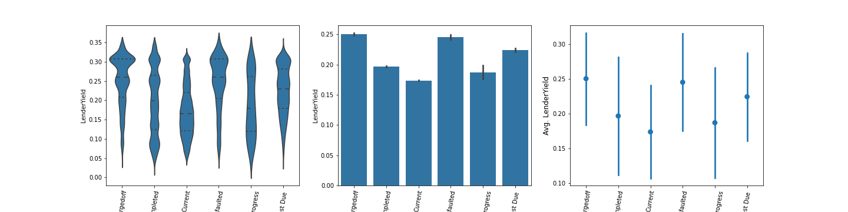
Relation between Loan Status and Lender Yield we see that Higher risk Higher interest rate.

Slide 26
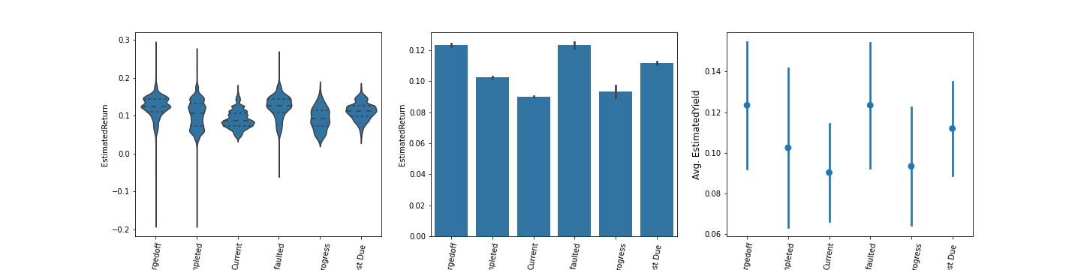
Relation between Loan Status and Estimated Return Rate
As we see there's higher Estimated return with defaulted and charged off Loans Status, So the higher return involved with higher Loan risk.

Slide 27
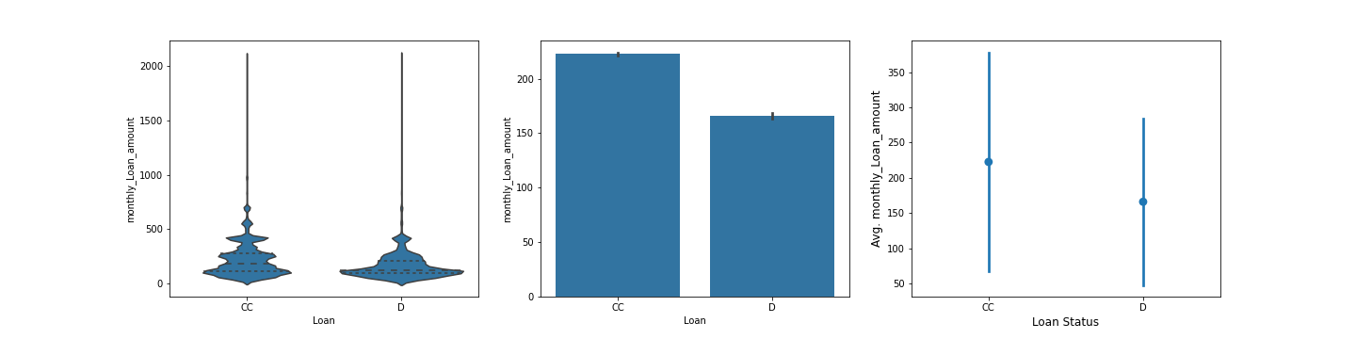
Relation between Loan Status and Monthly Laon amount
The Current and Completed Loan Status have higher Monthly Loan Amount than other defaulters.

Slide 28
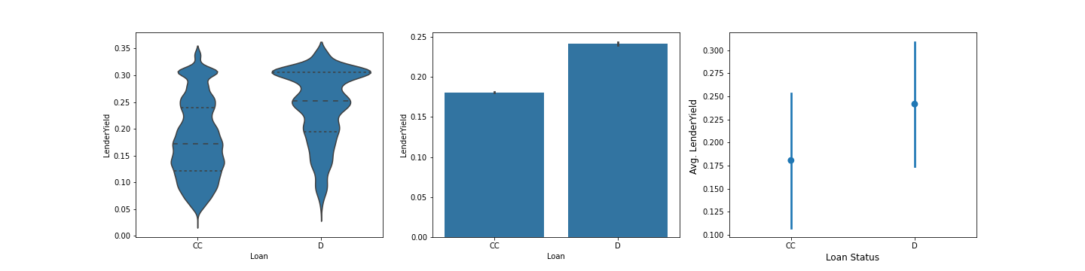
Relation between Loan Status and Interest Rate
The CCs have less interest rate than Ds.

Slide 29
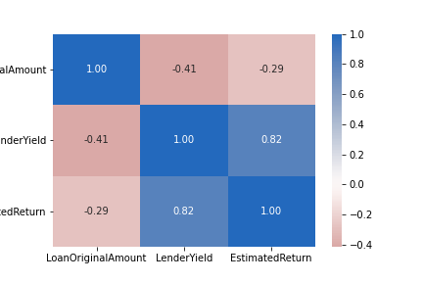
The Correlation between Loan Amount, Lender Yield and Estimated Return
It seems like we have some strong correlation, so we need to see it in scatter plot first to clearly judge.

Slide 30
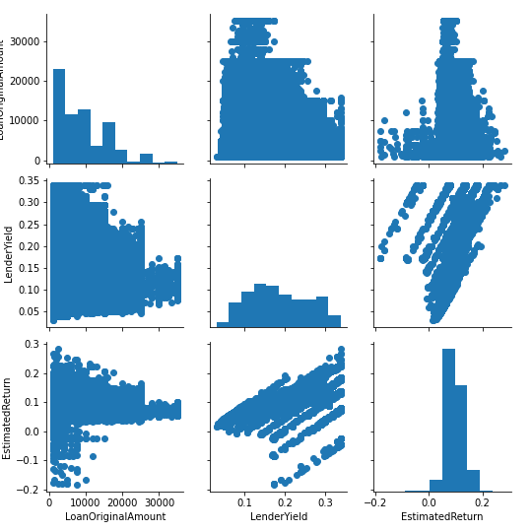
The Scatter plots For clear understanding
. There's a Weak Negative correlation between Estimated return and Loan amount.
. There’s an Average Negative correlation between Lender Yield and Loan amount.
. There's a Strong Positive correlation between Estimated return and Lender Yield.

Slide 31
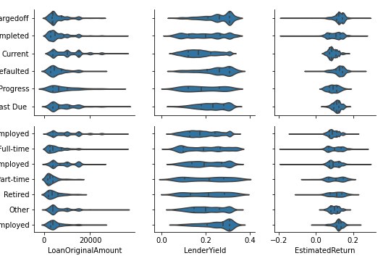
Relation between Loan Status, Employment Status, Loan Amount, Lender Yield and Estimated Return from the first column we see Higher Loan Amount tends to go to the employment direction and current status. and from the other two columns we see that the more risk the more gain.

Slide 32
Summary of findings in second exploration of Bivariate
I got more insights. Found that higher loan amount tends to have more loans of current status.
That is, interest rates are lower on higher loan amounts.
Debt consolidation is the higher in all status, Especially current status
Being a Defaulter has no excuse, there are defaulters even with an income of 100,000+ !!
It's quite not clear but higher score tends to complete the loan I see in Current Status there's more homeowners.
The current and Completed status tends to have Employed status
I see that the middle class then the rich people gets more loans specially in current Status.
the more investors we have the more completed loans we get.
there's higher Estimated return with defaulted and charged off Loans Status, So the higher return involved with higher Loan risk.

Slide 33

Multivariate Exploration of The Data

Slide 34
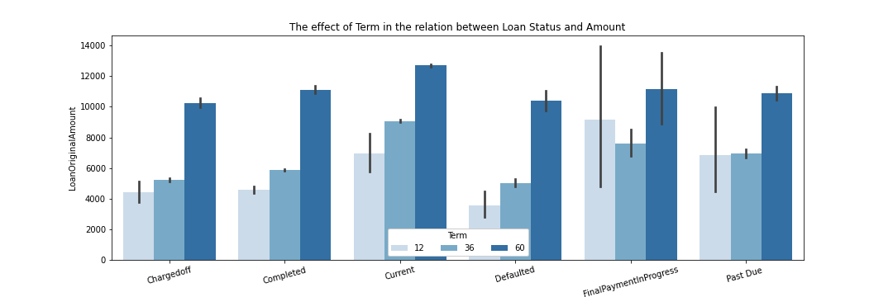
The effect of Term in the relation between Loan Status and Amount
The bigger loan amount tends to have higher months term.
The variability is higher in lower months term.
The Current, Completed and Final Payment In Progress Status are the higher Loan amount with higher months term.

Slide 35
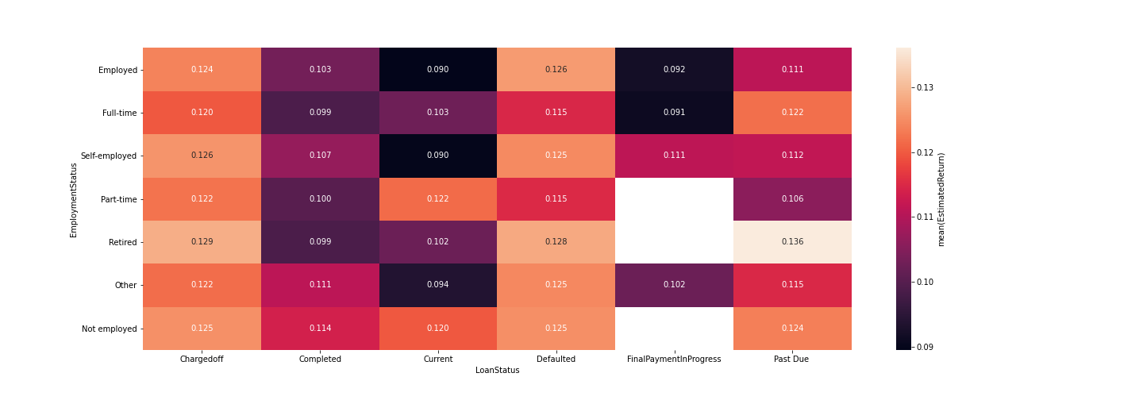
the effect of Estimated Return Rate in the relation between Loan and Employment Status
As we see all factors that effect the risk tends to have higher Return

Slide 36
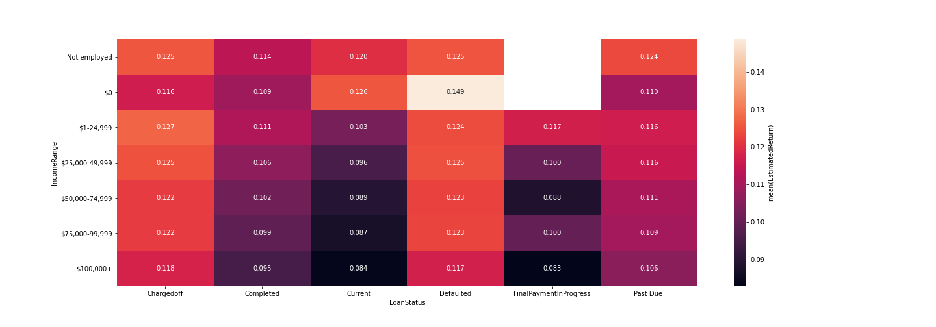
The effect of Estimated Return Rate in the relation between Loan Status and Income Range
High Risk High Return.

Slide 37
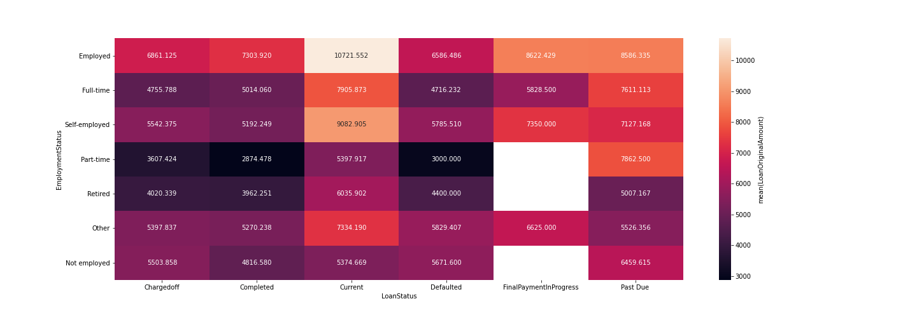
The effect of Loan Amount in the Relation between Loan Status and Income Range
It looks like each Employment status is normally distributed around the current Loan Status,
and higher amount of loans goes to Employment direction.

Slide 38
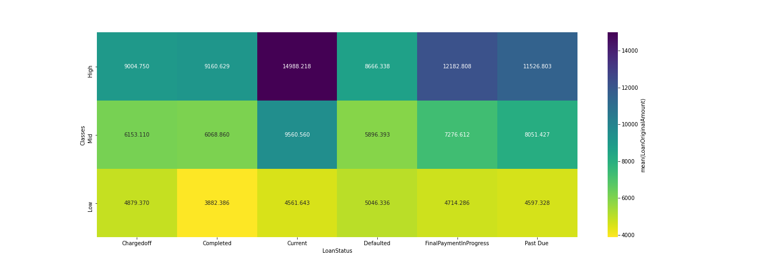
The effect of Loan Amount in the Relation between Loan Status and Social Classes
As we see, The High class takes high Loan Amount in average, and it goes down as we go to lower income rate
most of High class --> Current Status then final payment in progress
most of Mid class --> Current Status then past due.
most of low class --> Defaulted Status then charged off.

Slide 39
Conclusion
The Social class effect the Loan status directly and we can see that from the Income Range and Employment Status.
The amount of the loan effect the loan status too.
The interest rate is related to the estimated return and effect the loan status.
I got That bankers are fraudulent and has high procurement.

Slide 40

Thanks

